Slide 1
LIBRARY MANAGEMENT SYSTEM
Presented by :
SURAJ KUMAR GUPTA

Slide 2
Introduction
Library Management System is an application which refers to library systems which are generally small or medium in size. It is used by librarian to manage the library record various transactions like issue of books, return of books, addition of new books, addition of new students etc. Books and student maintenance modules are also included in this system which would keep track of the students using the library and also a detailed description about the books a library contains.. In addition , report module is also included in Library Management System .

Slide 3
OVERVIEW
To build a library management which contains two login :- Student and Admin(librarian).
There will be various features like
Searching of books
Issuing and returning books
Paying fine(if any) online
Librarian can read information about any member
Librarian can track the books issued by a particular student

Slide 4
REQUIREMENTS
The Library Management System shall be required to maintain information about its users and books.
It shall store databases for students, staff and books.
The student database stores information about a student’s roll no/ID, name, phone no, email and book count.
The book database stores information about a book title, author, ISBN no, quantity.
The teacher database stores information about a staff id, name, password.

Slide 5
DRAWBACKS OF PRESENT SYSTEM
File lost
Difficult to search record
Space consuming
Cost consuming
Time consuming
Information about issue/return of the books are not properly maintained.
No central database can be created as information is not available in database.

Slide 6
TECHNOLOGY USED
Programming Language : Python
OS Used :Window 10
Database : My SQL

Slide 7

Module 1 - Student Login / Admin Login
Authentication of the user will be there.
Username and password will be matched from our database. Once both username and password matches, then only a user is allowed to enter into the system.
Similarly for admin there will be a authentication system.

Slide 8
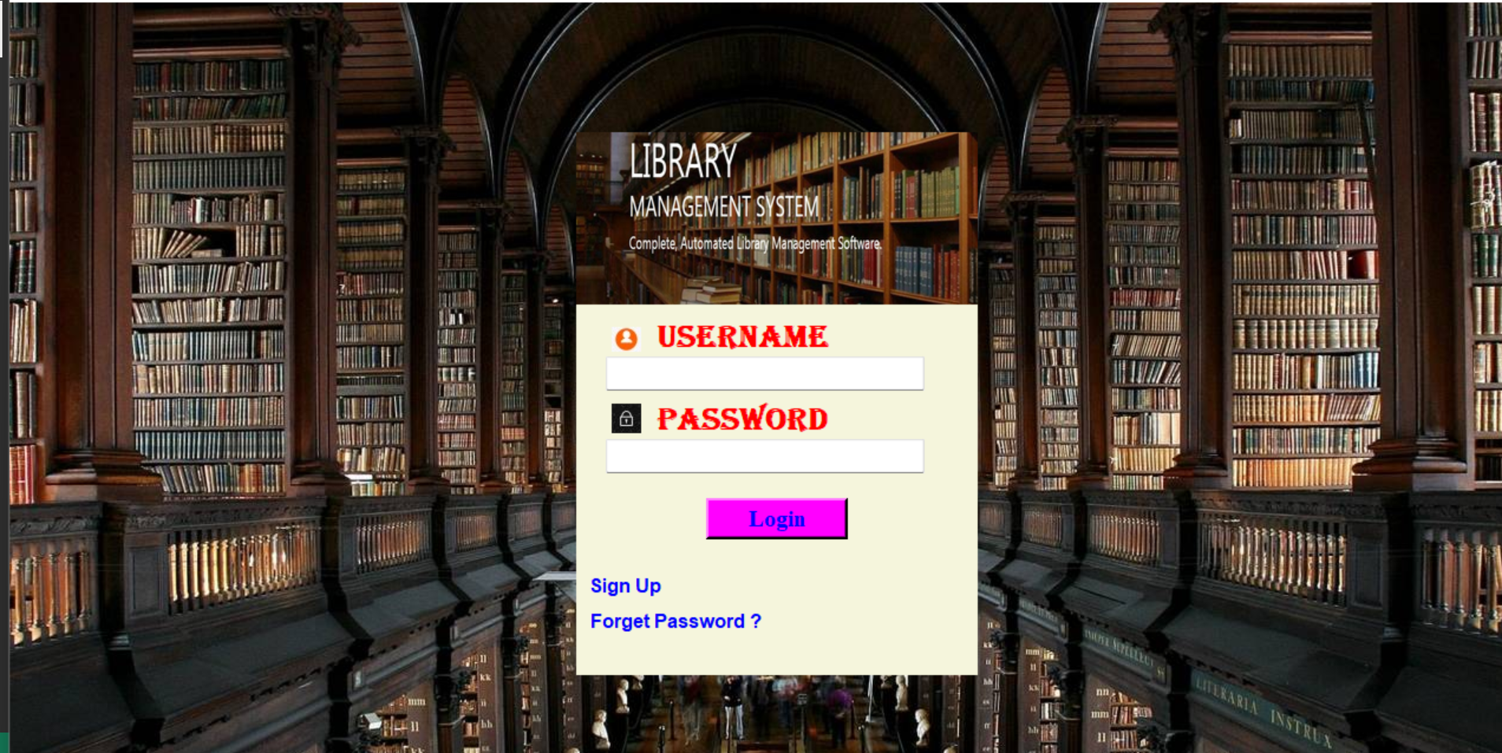

Slide 9
Module 2 - Signup For New User
For new users there will be sign up option
Various details like registration number , username , password etc. will be taken from the user and then it will be updated in our database.
After this , the user will be redirected to the login page.

Slide 10
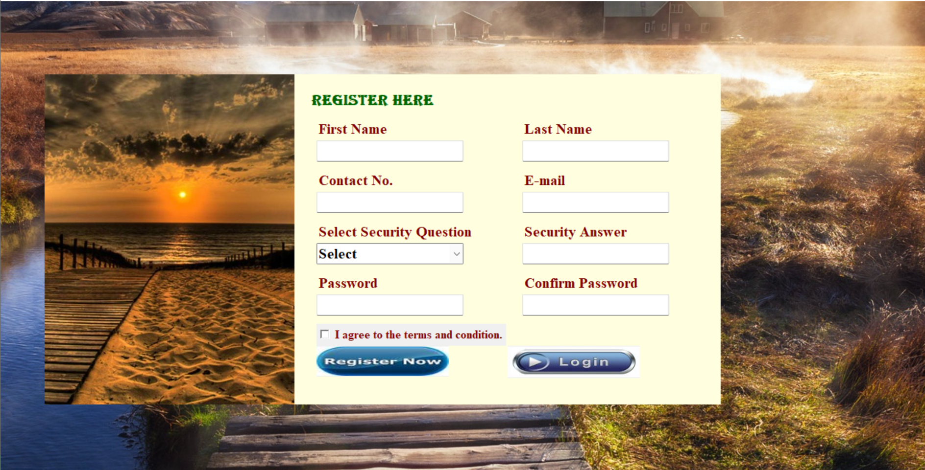

Slide 11
Module 3 - Student Profile
After successful login into system, user can see its details
Various details which will be shown are:-
Issued books
Date of issue
When to return
Current fine the user has to pay
Searching book in the library.

Slide 12
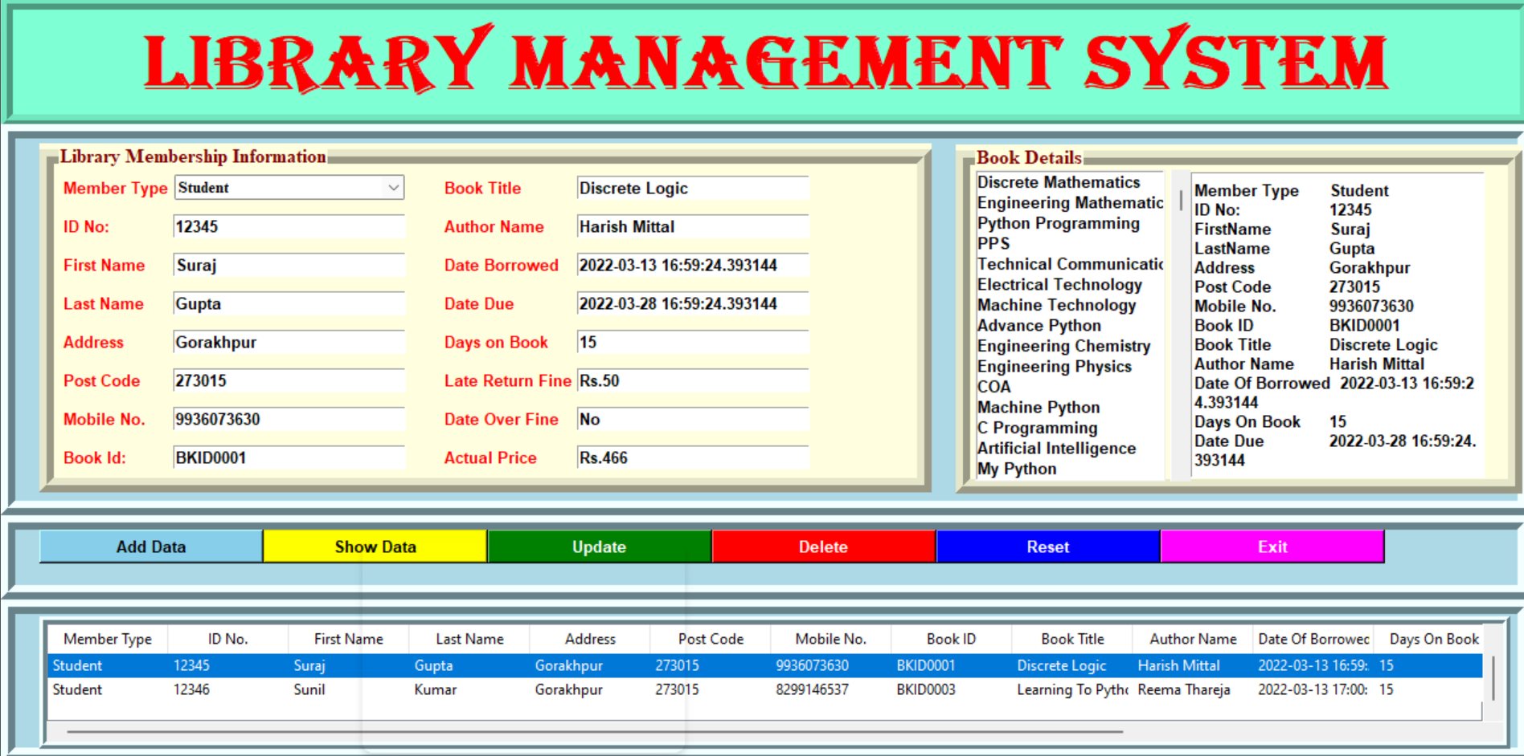

Slide 13
Module 4 - Admin Panel
After successful login admin can keep track of the books issued
It can also track various other details such as
Fine of all students.
Which book is issued by the student
The number of copies of book which can help the librarian to know which book to order.

Slide 14
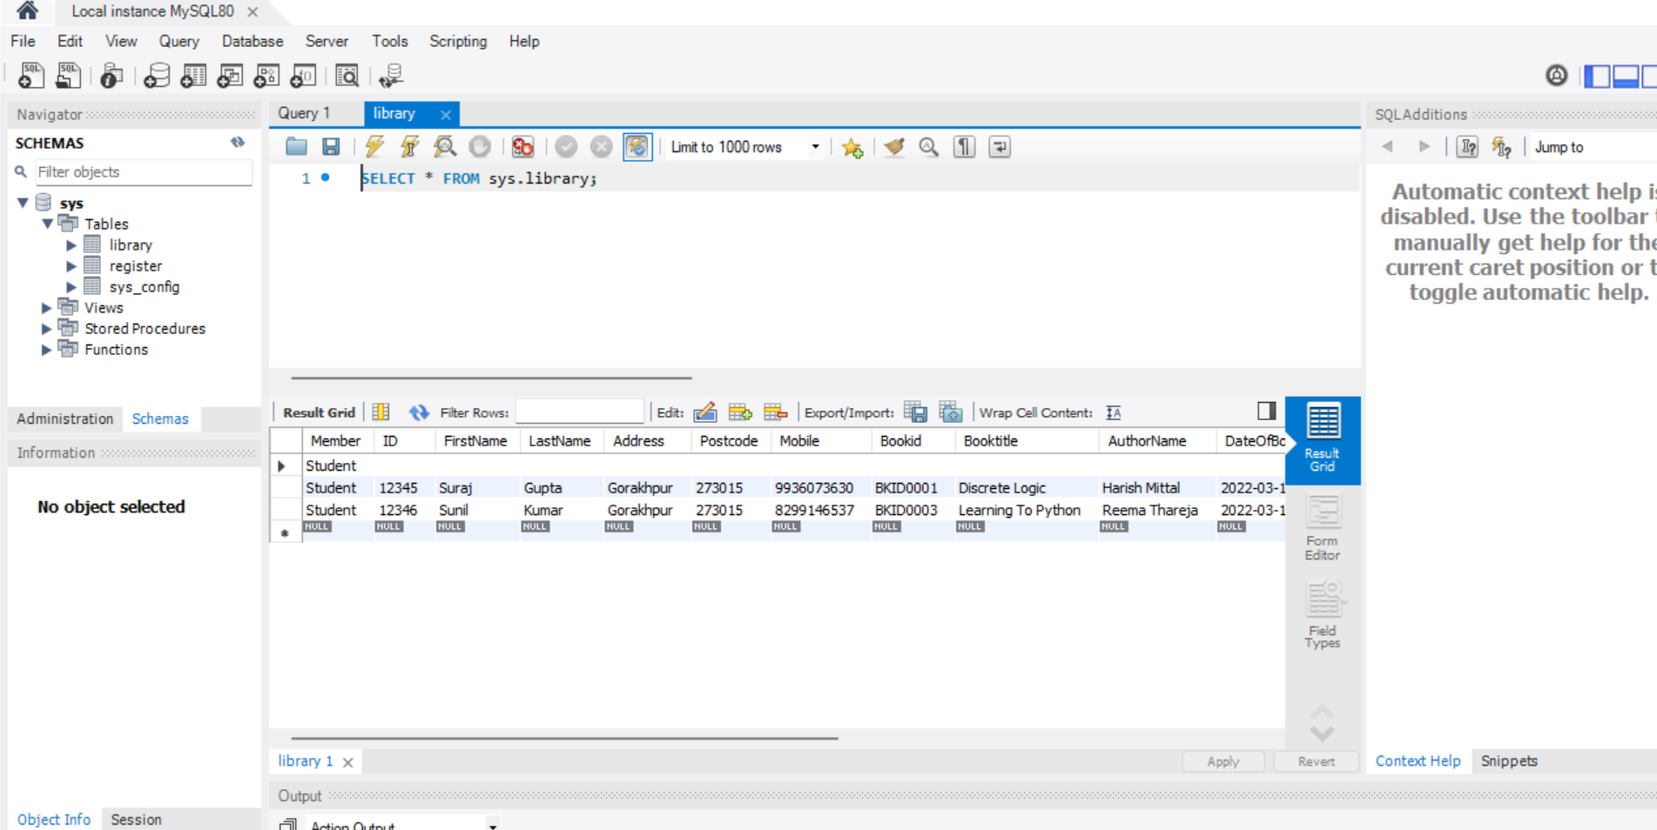

Slide 15
Module 5 – Book Search
Books present in the library can be searched
The books can be searched on various parameters such as
Subject wise Search- If a student wants a book related to open source programming then system will show all the books related to osp present in the library .
Author Wise Search- Can search a book on particular author. The system will show all the books on that author available in the library
Year Wise Search- Searching a book based on particular edition will be available.

Slide 16
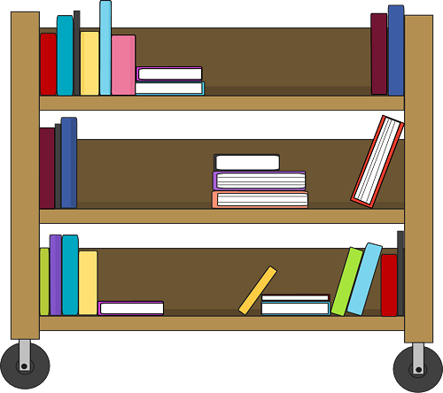
Module 6 - Feedback
Feedback will be taken from the user related to our system and all the feedback will be stored in a database and will be displayed in admin login which will help us to remove all the bugs and improve our library management system.

Slide 17
Bibliography
Books
➢ Software Engineering 3rd Edition (K. K. Aggarwal)
➢ Fundamentals of Database System Seventh Edition (Ramez Elmasri, Shamkant B. Navathe)
➢ Python The Complete Reference (Martin C. Brown)
➢ Using SQLite (Jay A. Kreibich)
Websites
✓ https://www.w3schools.com/python/
✓ https://www.tutorialspoint.com/sqlite/
✓ https://www.tutorialspoint.com/dbms/
✓ http://www.w3schools.com/sql/sql_update.asp

Slide 18


